Slide 1
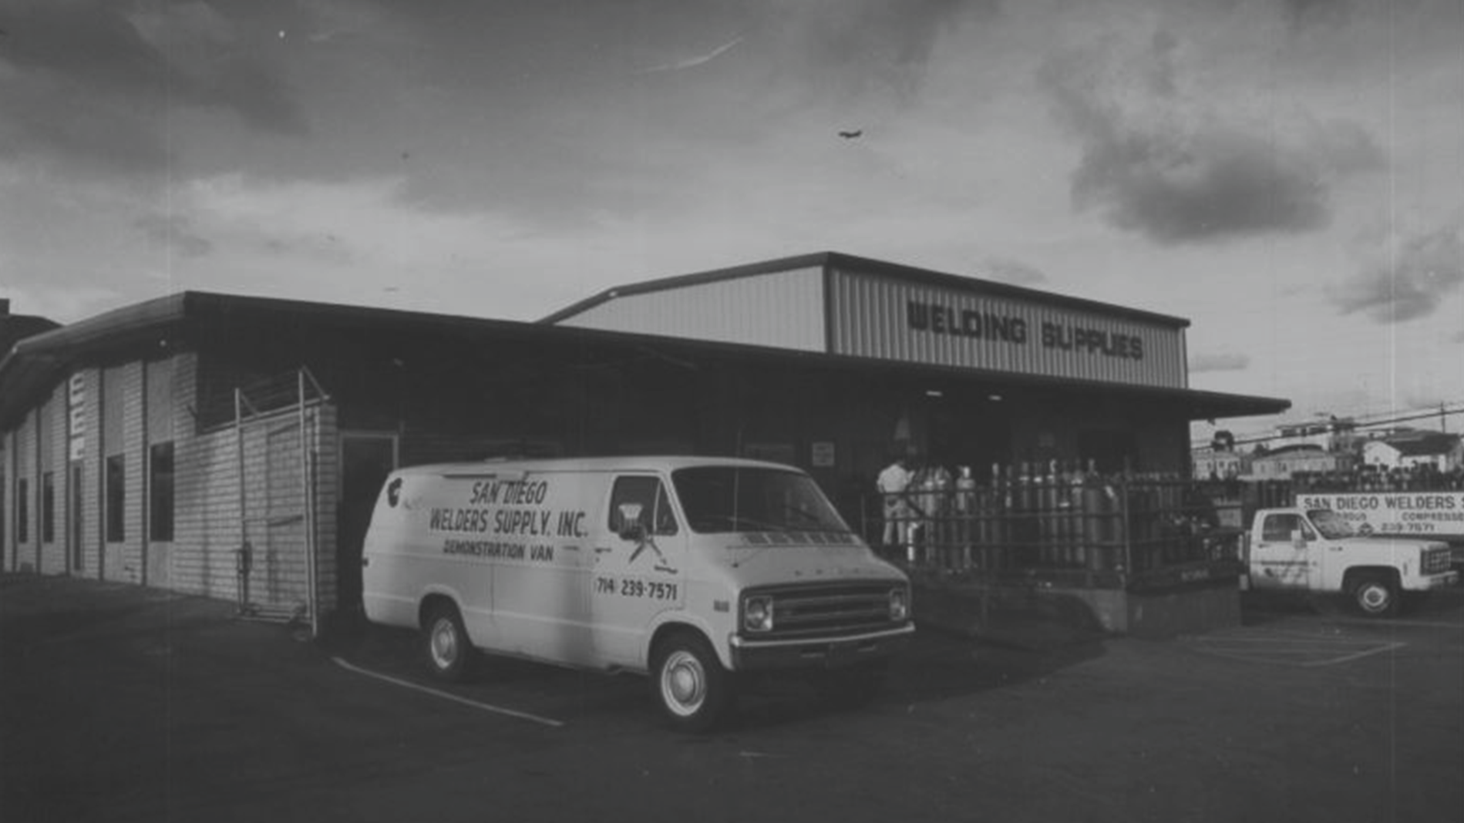
[date/month/season] [year]
WestAir: [Title of meeting]
Family-owned & operated since 1970.
Service worth rallying around.
(866) WestAir | westairgases.com
@westairgases

Slide 2
[TOC/Overview Page]
Family-owned & operated since 1970.
Introduction
Section 1. . . . . . . . . . . . . . . . . .
Subtitle 1
Line with orange background
Section 2 . . . . . . . . . . . . . . . . .
Subtitle 2
Line with orange background
Section 3 . . . . . . . . . . . . . . . . .
Subtitle 3
[Quote or relevant statement]
Line with orange background
Section 4 . . . . . . . . . . . . . . . . .
Subtitle 4
Line with orange background
— [Author/speaker]

Slide 3
[Numbers Page]
Family-owned & operated since 1970.
Capital Equipment Purchases Cylinders & Bulk Tanks H2/HE Tube Trailers (6) Cylinder Pallets
CO2 10-Ton Microbulk CO2 Transport Fontana Location TI’s
3-Axle Tractor w/Hydraulic PTO Adelanto Location Solar Project Other Equipment
YTD Total
Equipment on Order Five (5) H2 Tube Trailers
Four (4) JUMBO N2 Transports Cylinders & Bulk Tanks
One (1) LIN/LAR Orca One (1) AR Transport Total on Order
$1.6m
$1.5m
$305k
$290k
$238k
$203k
$193k
$92k
$1.9m
$6.3m
$1.1m
$856k
$X.Xm
$514k
$291k
$2.8m

Slide 4
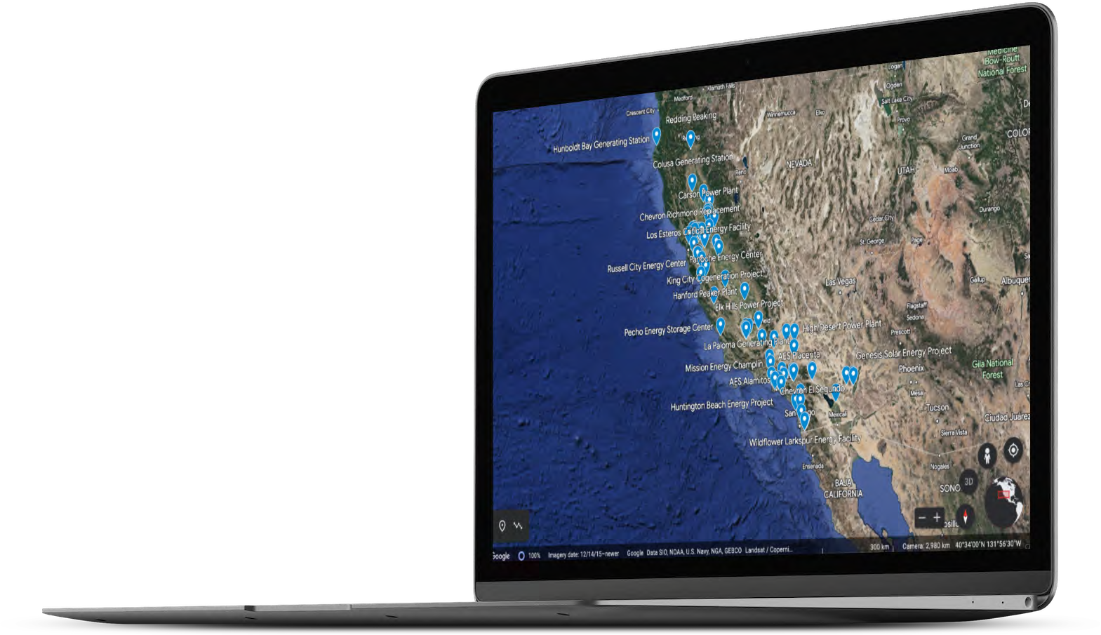
[Half Page with picture]
Family-owned & operated since 1970.
[overview info or bullet points here]
-
-
-

Slide 5
[Tricolumn page]
Family-owned & operated since 1970.
Column 2
Info/statistics/data
Clarifying info
Expanding on subtitle
Column 3
Info/statistics/data
Clarifying info
Expanding on subtitle
Part 1
Subtitle
Part 2
Subtitle
Part 3
Subtitle
Part 4
Subtitle
Part 5
Subtitle
Column 2
Info/statistics/data
Clarifying info
Expanding on subtitle

Slide 6
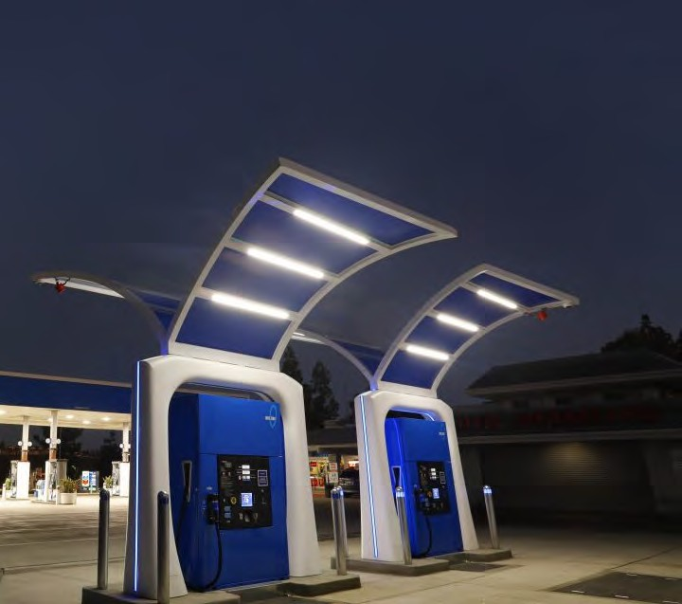
[Page emphasizing picture]
Family-owned & operated since 1970.
Commentary on replaceable image
Subtitle
Anecdote
Statistics
Basic info
Supporting evidence

Slide 7
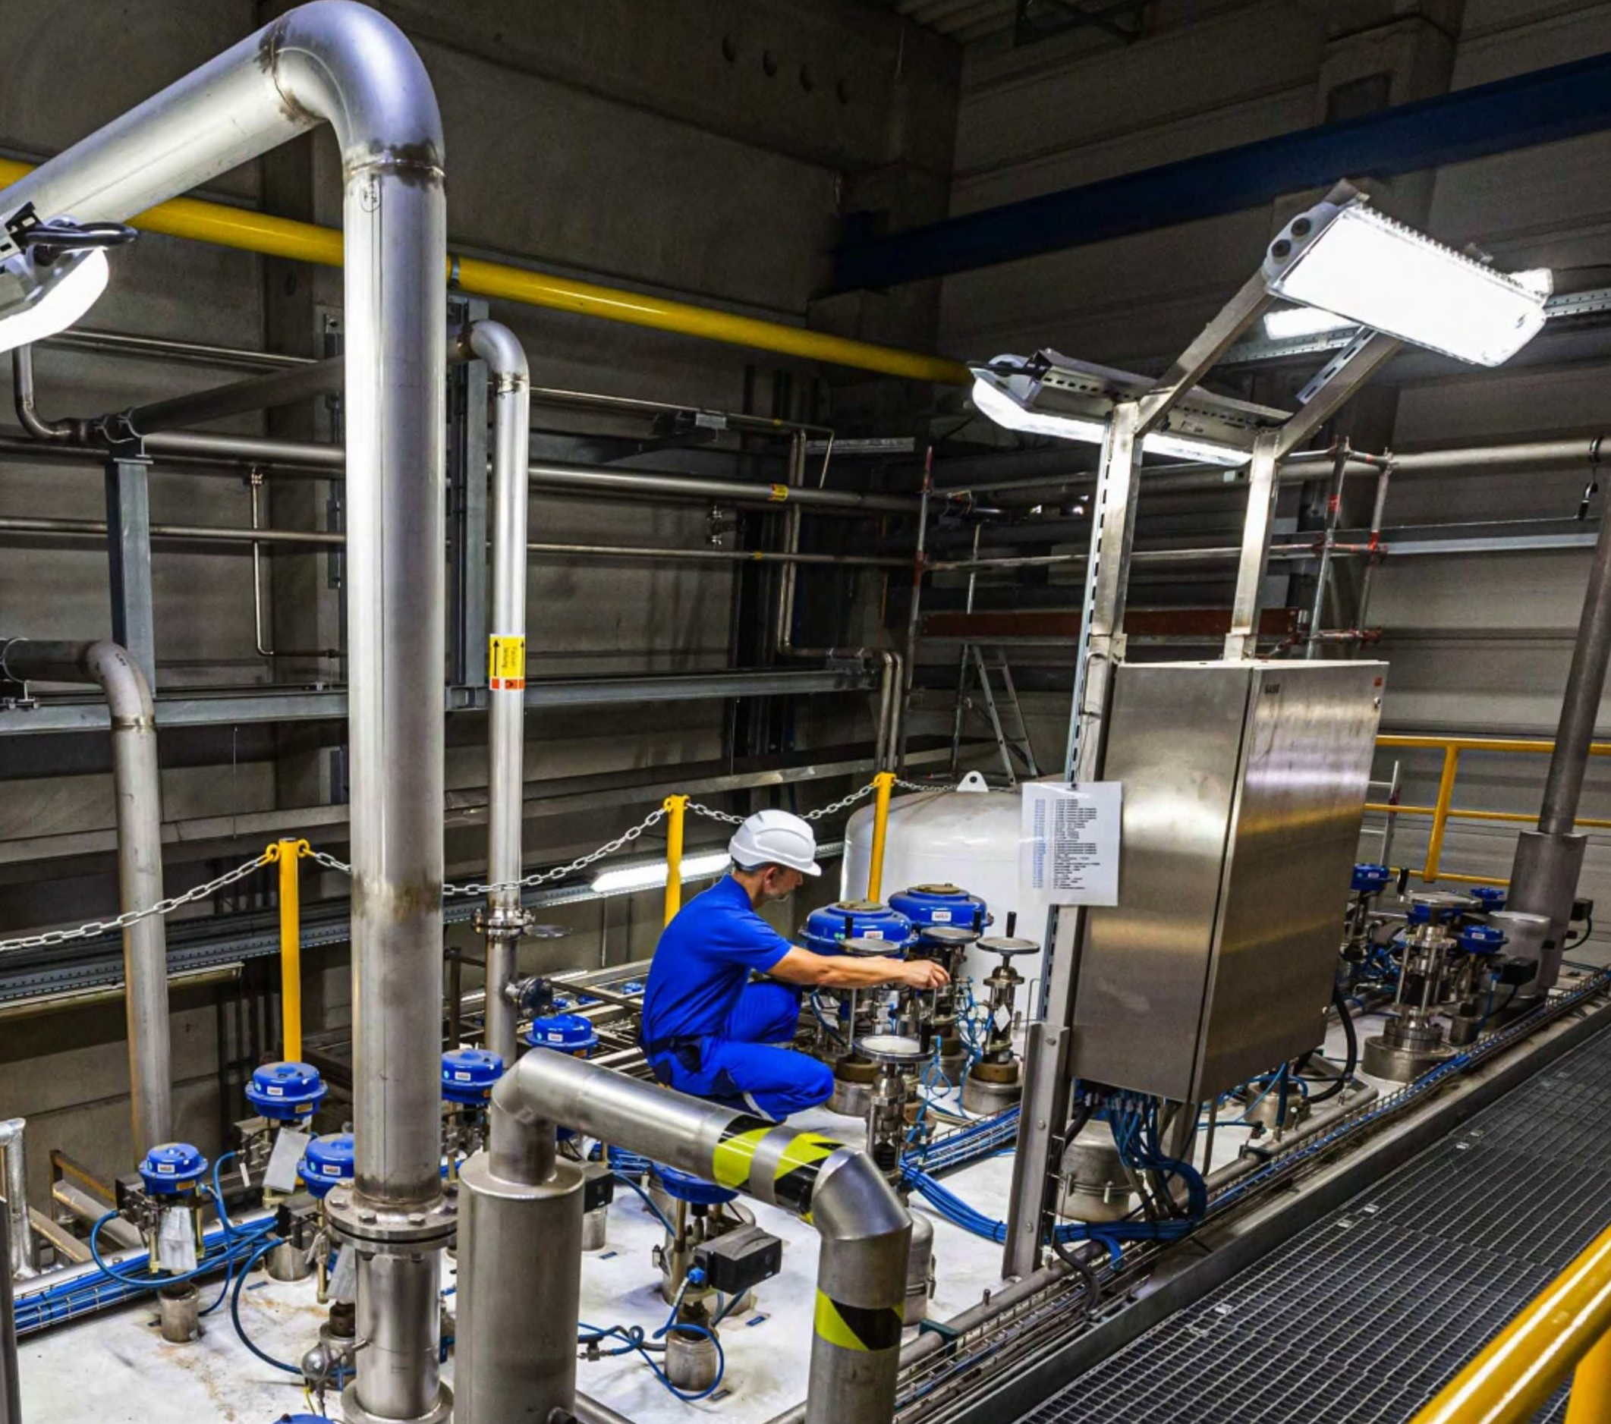
Family-owned & operated since 1970.
[Title]
Anecdote/statistic/info
Supporting evidence
Supporting evidence
[Subtitle]

Slide 8
[Graph/Graphic Page]
Family-owned & operated since 1970.
Describing Numbers
Clarifying info
Graph 3
Graph 2
Describing graphs
Clarifying info
Graph 1
Legend explanation
Section 1 Section 2
Section 3 Section 4
Year/Sector
Year/Sector
Year/Sector

Slide 9
[Analysis Page]
Family-owned & operated since 1970.
Title
Section 1 . . . . . . . . . . . . . . . . .
Subtitle 1
Line with orange background
Section 2 . . . . . . . . . . . . . . . . .
Subtitle 2
Line with orange background
Section 3 . . . . . . . . . . . . . . . .
Subtitle 3
Line with orange background
Subtitle 5
Subtitle 4
Line with orange background

Slide 10
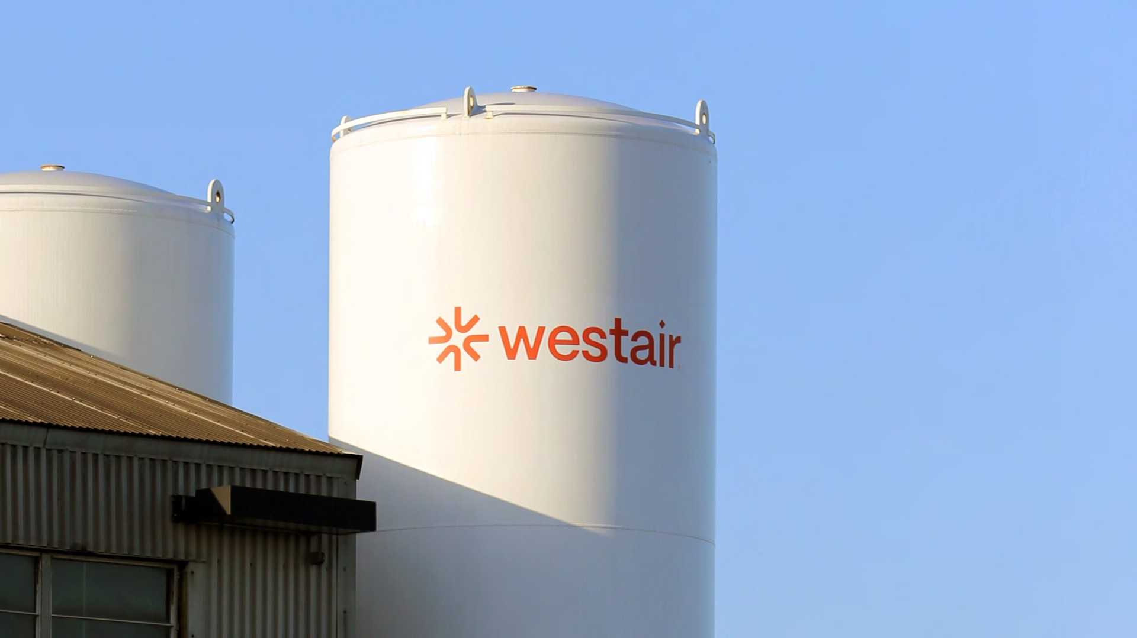
[Page emphasizing picture]
Family-owned & operated since 1970.
ICON*
WORDMARK*
Four (4) generations of Castigliones; decades of service from employees
70° Rounded edges
Diamond “tittle”
‘A’ nod to liquid gases
Shows “rally around”
The four (4) main atmospheric gas groups
A Spark: Employing Illusion The Hermann Grid Effect* (Est. 1870)
LOGO*
size matters: The family-owned independent gas distributor who better serves their customers & is unfazed by the global brands that dominate the industry.
Notes:
Full page picture

Slide 11
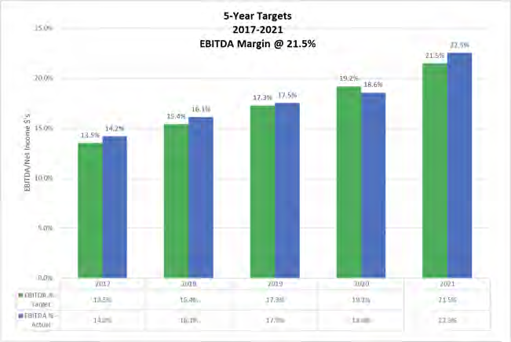
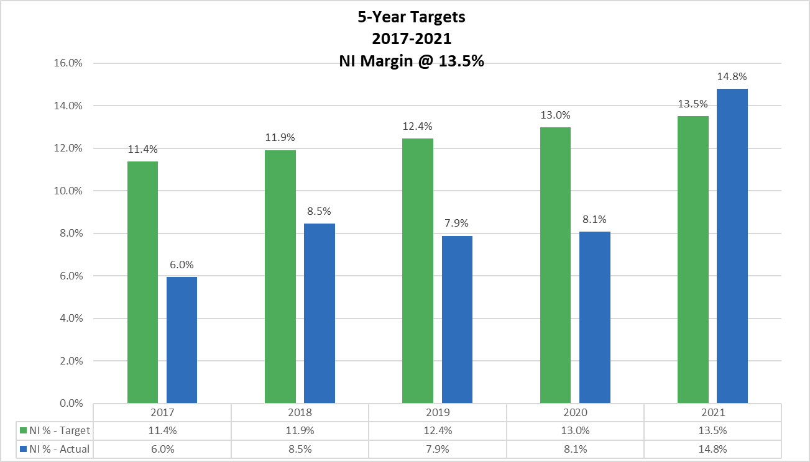
[Analyzing Graphs]
Family-owned & operated since 1970.
Points about graph
Statistical Data
Statistical Data

Slide 12
[Comparing Numbers]
Family-owned & operated since 1970.
WestAir VAR -- F/(U) to Airgas/Praxair*
% of Revenue | FY 2021 | FY 2022
Revenue | 0.0% | 0.0%
COS | 8.6% | 10.2%
Gross Margin % | 8.6% | 10.2%
Operating Expenses | -16.1% | -17.0%
EBITDA | -7.5% | -6.8%
Other Expense / Income | 2.4% | 1.4%
Taxes | -0.1% | -0.1%
Interest | -0.4% | -0.6%
Depreciation | 5.8% | 6.3%
Net Income (Loss) | 0.1% | 0.2%
Revenue Per Employee | $1,341 | $25,975

Slide 13
[Analyzing data]
[subtitle]
Family-owned & operated since 1970.
[data]
($'s in M's)
BIG Average excl WestAir
84.5 $
41.9 $
Airgas/Praxair Combined Avg
Revenue Gross Profit
$
$
30,086
14,769
$
$
WestAir
122.2
72.3
GM %
49.5%
49.1%
59.2%
Observations
analysis
Operating Expenses
Personnel Occupancy Selling Vehicle
Plant & Operating General & Admin
$
$
$
$
$
$
21.5 $
2.5 $
0.2 $
4.3 $
1.7 $
5.5 $
4,513
301
60
527
361
286
$
$
$
$
$
$
31.2
1.8
0.2
5.0
2.2
4.9
TOTAL
$
35.7 $
6,047
$
45.4
EBITDA NI
$
$
6.2 $
3.1
8,721
$
$
26.9
13.6
Analysis
Data points to draw attention to
EBITDA Margin %
NI %
Opex % Gas & Rent
7.3%
3.7%
42.2%
54.7%
29.0%
0.0%
20.1%
22.0%
11.1%
37.2%
62.5%
HC
RPE
# of Branches
190.5
443,702 $
69630.0
432,081
276.5
442,045
18.0
$
16.1
$
Personnel Occupancy Selling Vehicle
% Rev
% Rev
% Rev
% Rev
25.40%
3.00%
0.20%
5.10%
2.00%
6.50%
42.20%
15.00%
1.00%
0.20%
1.75%
1.20%
0.95%
20.10%
25.57%
1.51%
0.19%
4.09%
1.78%
4.04%
37.18%
Plant & Operating % Rev General & Admin % Rev

Slide 14
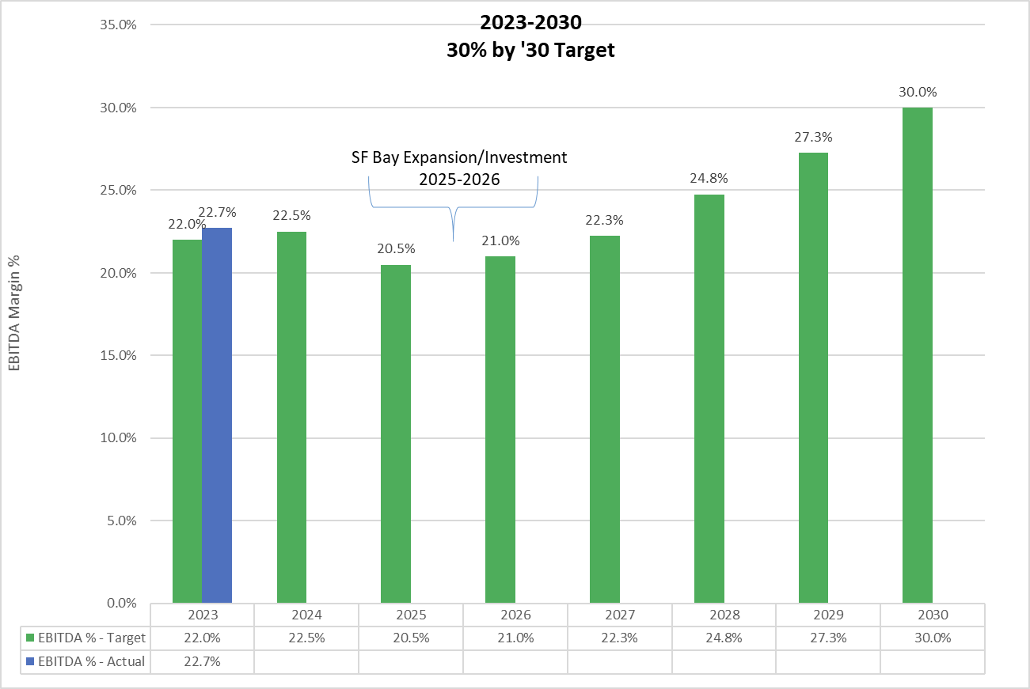
[Bar Graph Page ]
Family-owned & operated since 1970.
[subtitle]
Analyzing data
Recognizing Trends
How to use this data
What it means for us/the customer

Slide 15
[Closing Page]
[Closing Message]
Family-owned & operated since 1970.
Service worth rallying around.
Have questions? Drop us a line at hello@westairgases.com

