Slide 1
Getting started
Instructions (delete before presenting)
Use this template as a starting file for your presentation.
First, make a copy of the template, and only edit the copy. Keep the template for future use.
Use the slide templates and icons you need, then delete the ones you don’t need.
Once you are done, make sure to also delete these instructional slides.
Only use branded colors, as outlined in the instructions. Avoid using any other color variation.
Save your presentation as a PDF before sharing to reduce the file size.

Slide 2
Branded colors
Instructions (delete before presenting)
Please make sure you are using the right colors. The next slide explains how to change colors.
Supporting colors (mainly for dark backgrounds): Unitaid Grey: #E6EAEE
Unitaid Sky Blue: #75D8F7
Unitaid Bright Green: #00F7B6
Unitaid Green: #00C77D
Unitaid Orange: #FF451A
Unitaid Magenta: #CC33CC
Unitaid Burgundy: #7B0051
Black (body text): #000000
Notes:
Don’t use more than 5 colors, including white
Don’t pair Red with Bright Green or Green
Don’t pair Blue with Orange
Primary colors:
Unitaid Navy: #212E92
Unitaid Blue: #0066FF
Unitaid Red: #CC0033
White: #FFFFFF

Slide 3
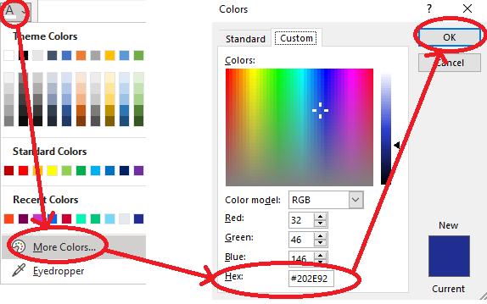
Branded colors
Instructions (delete before presenting)
Only use exact colors. Avoid approximating colors or using any other colors. Follow these instructions to change the color of your text to Unitaid-branded colors.

Slide 4
Icons (Unitaid Navy)
Instructions (delete before presenting)
Here is a selection of icons that you may copy-paste in your slides, where needed. You may also find the full, regularly updated list of icons under the ‘icons’ section of brandpad.io/unitaid.

Slide 5
Cover slides
Instructions (delete before presenting)

Slide 25
Dividers
Instructions (delete before presenting)

Slide 42
Content slides
Instructions (delete before presenting)

Slide 43
Contents

Slide 44
Contents

Slide 45
Contents
1
4
2
5
3
6

Slide 46
Contents

Slide 48
Contents

